Slide 1
Predictive Modeling of Funding for Kiva Microloans
Morgan D. Kauffman

Slide 2
Kiva’s Data Science For Good
https://www.kaggle.com/kiva/data-science-for-good-kiva-crowdfunding
Kiva’s original posting
671k loans, with no details on outcomes, only on the loans themselves
https://www.kaggle.com/gaborfodor/additional-kiva-snapshot
More expansive snapshot, which includes the same loans as Kiva’s official one
1.2 million loans, with details on borrowers, loan usages, and outcomes, stretching from 06/2006 to 01/2018
Includes datasets containing loan coordinates and national statistics
See https://www.kiva.org/about/how for more info

Slide 3
Philanthropic-Lender business model
Borrowers create profiles for their loans on Kiva’s website
Microlenders give money to fund the loans
Minimum of only $25 USD per lender per loan
Borrower gets the loan, then pays it back (or not) over time
Interest is minimal, usually only enough to offset Kiva’s costs in making the loan
Neither Kiva nor lenders profit off of loans; entirely philanthropic
Kiva serves as a means for small-scale philanthropists to donate money to worthy small-scale causes, and helps small businesses get off the ground in developing countries

Slide 4
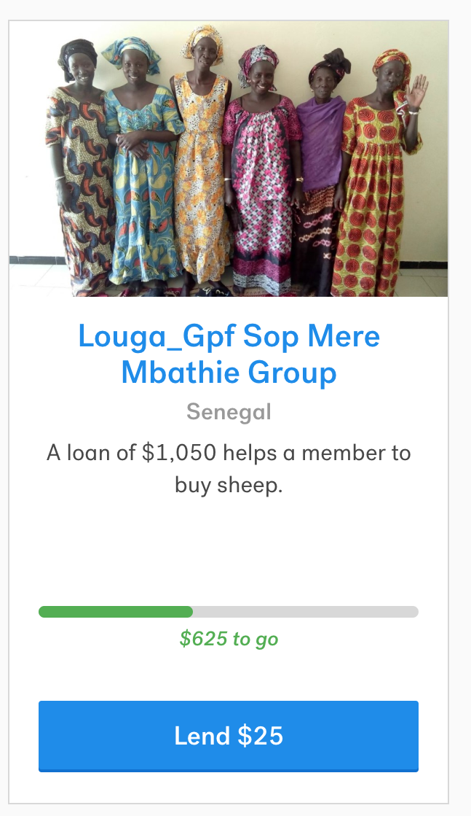
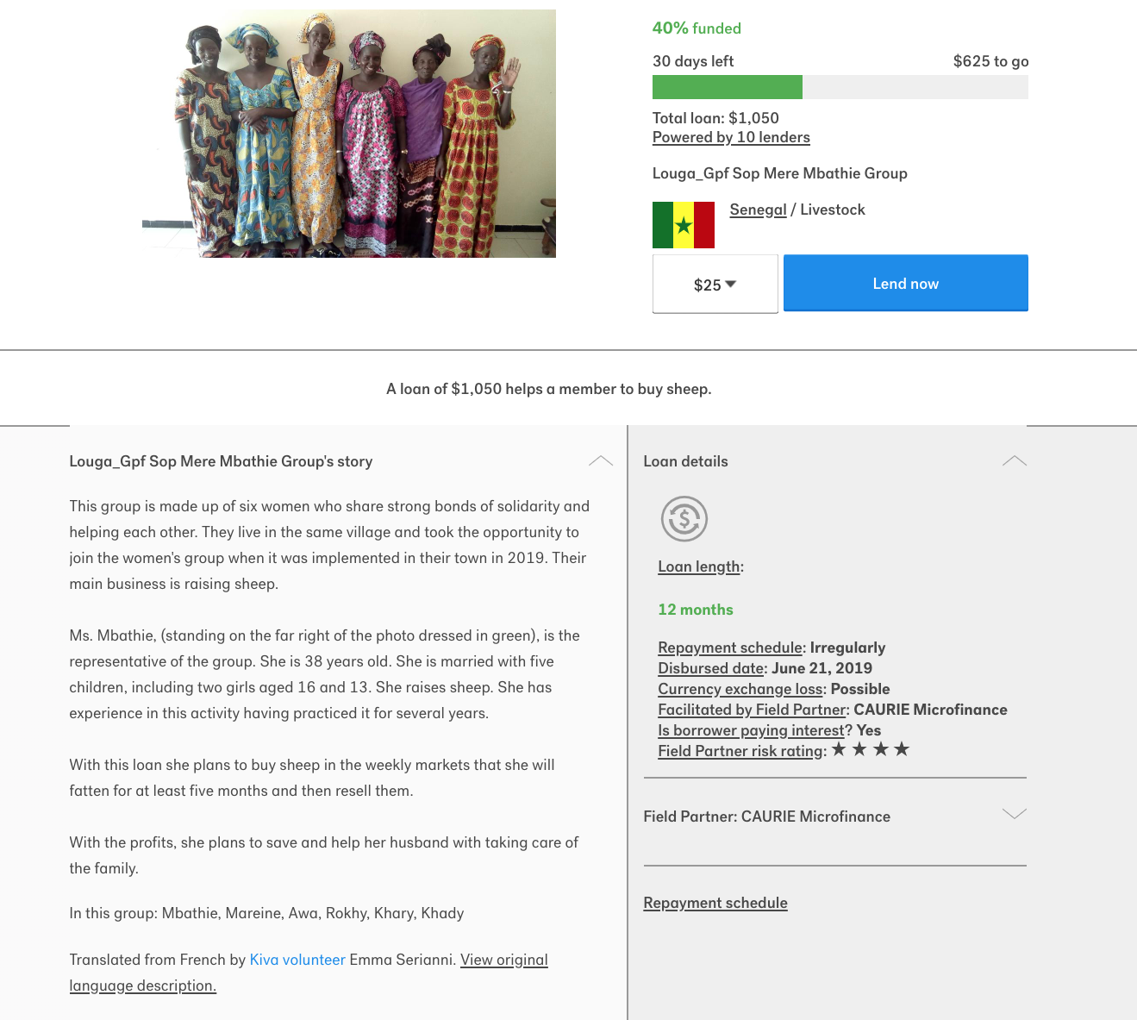
1st result in Kiva’s current listing
Available loans: https://www.kiva.org/lend
1st hit: https://www.kiva.org/lend/1789779

Slide 5
“Well now, that’s rather odd…”
Looking at the data, disburse time (when the money is disbursed to the borrower) is before the posting date (when the loan goes up on Kiva’ website) for some loans
Turns out that Kiva frequently works through local affiliates, who can extend credit immediately after a loan is approved by Kiva
Microlenders on Kiva.org aren’t actually the ones paying for the loan; Kiva and its affiliates are
A loan that isn’t fully funded just means that Kiva and/or its affiliate are the ones left holding the remaining debt
Kiva’s method of crowd-funding loans is fundamentally a means of redistributing risk away from itself by allowing small-scale lenders to participate in Kiva’s philanthropy

Slide 6
Unusual predictive opportunity
Most loan databases are fairly straightforward in what you want to predict: “how likely is a particular borrower to default on their loan?”
This one offers another aspect that’s almost as important to the business model: whether the loan gets funded or not
Failure to fund doesn’t mean anything to the borrower, but instead leaves Kiva and/or its affiliate holding the debt in case of default
Rather than distributing the risk, it’s left concentrated with Kiva, which doesn’t have the profit margin to absorb very many defaulted loans if the risks are realized
Being able to predict “failure to fund” would shore up a weak point in Kiva’s business model, offering them a chance to avoid or intervene in risky loan profiles

Slide 7
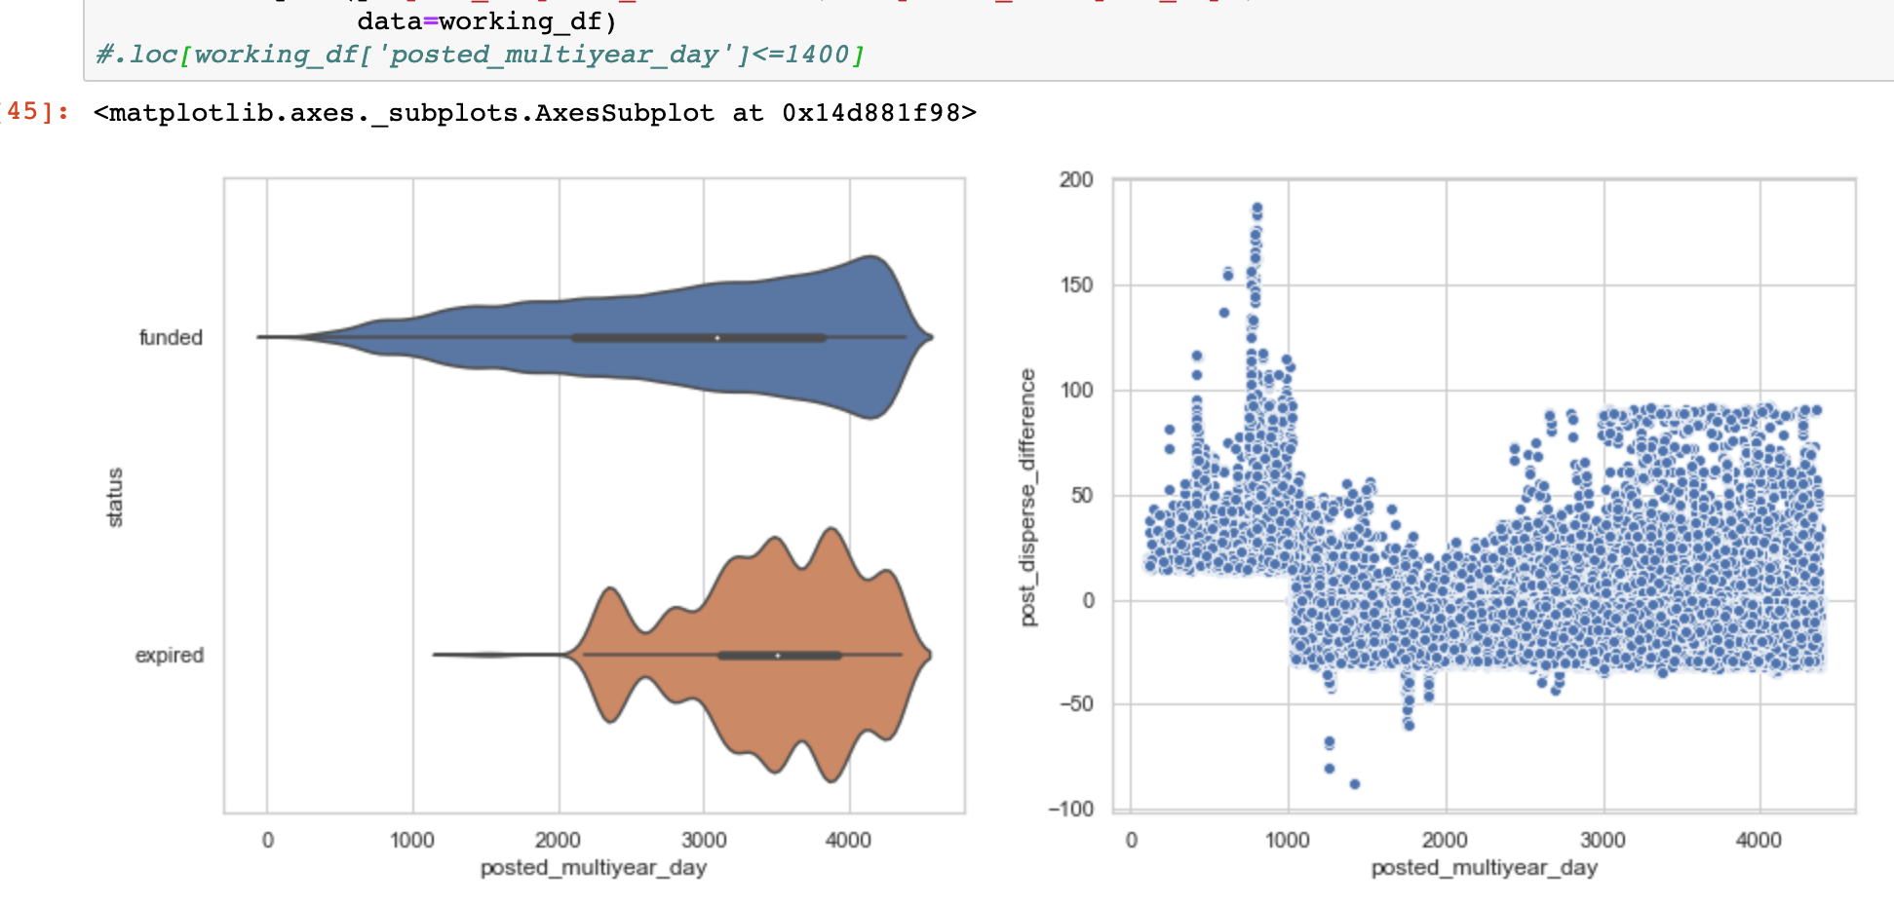
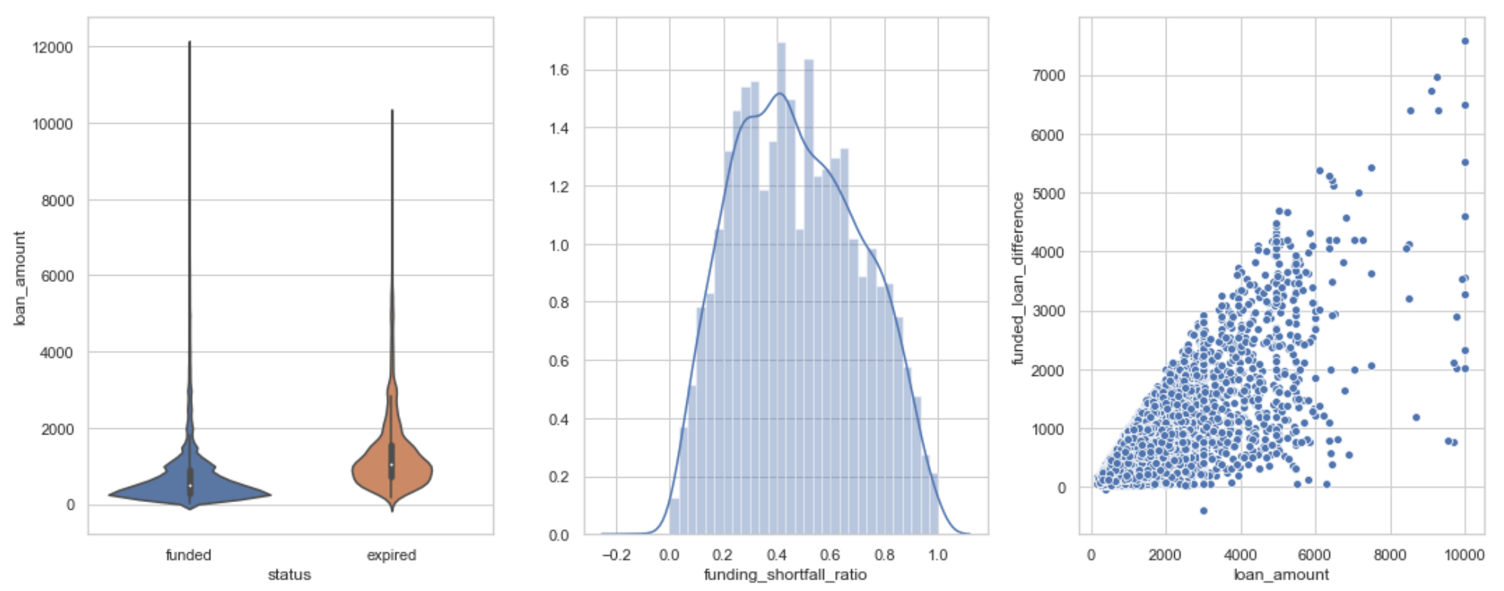

Slide 8
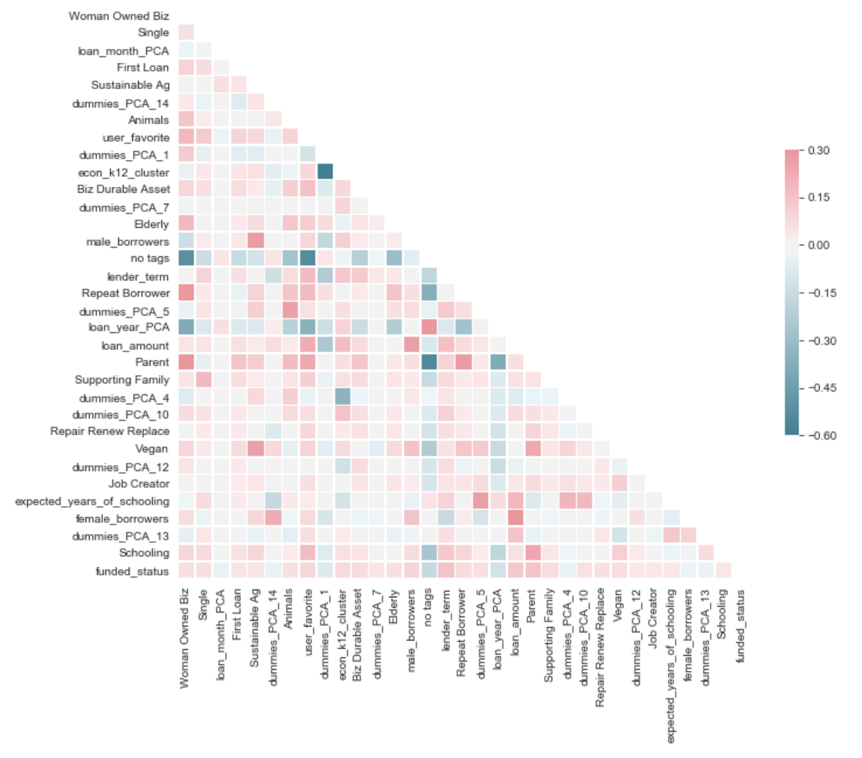
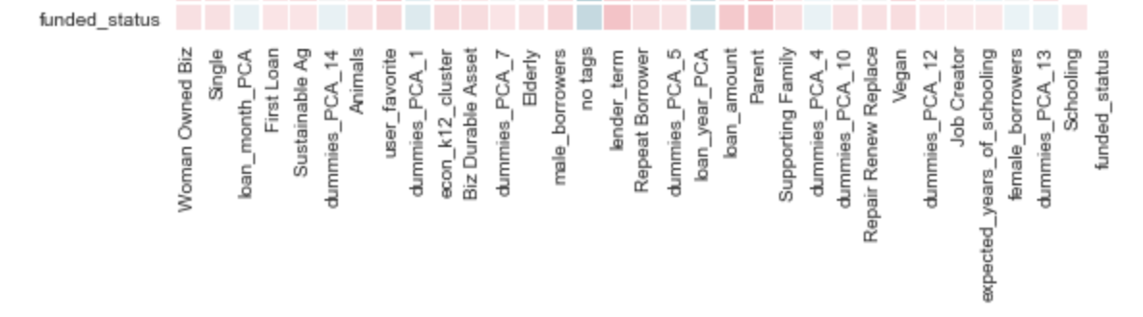
Correlation Heat Map

Slide 9
Base Features
Useless
loan_id
loan_name
planned_expiration_ time
currency_exchange_ coverage_rate
Target
funded_amount
status
raised_time
Post-Loan
num_lenders_total
num_journal_entries
num_bulk_entries
Useful
original_language
loan_amount
town_name
sector_name
activity_name
currency
currency_policy
partner_id
lender_term
repayment_interval
distribution_model
latitude
longitude
National Data
country_code
country_name_x
country_name_y
kiva_country_name
country_code3
continent
region
population
population_below_ poverty_line
hdi
life_expectancy
expected_years_of_ schooling
mean_years_of_ schooling
gni
Requires Processing
posted_time
disburse_time
tags
borrower_genders
borrower_pictured
Too Much Processing
description
description_translated
loan_use

Slide 10
Feature Processing
Time
Split strings:
(“2014-01-15 02:23:45.000 +0000”)
posted_time
disburse_time
Become…
posted_year / _month / _day
disburse_year / _month / _day
Translate month/day into time of year
posted_yearfraction
disburse_yearfraction
Translate into rough point in timeline
posted_multiyear_day
disburse_multiyear_day
Subtract posting from dispersal dates
post_disperse_difference
Borrower Gender & Count
Split strings (“female, female, male”) into counts of genders
male_borrowers
female_borrowers
Identify any mixed-gender borrower groups
mixed_gender_borrowers
Get total count of borrowers
borrower_count
Borrower Pictured
Split strings (“true, false, true”) into counts of pictured/unpictured
pictured_borrowers
unpictured_borrowers
Create ratio, 1 = all pictured, 0 = none
pictured_ratio
Tags
Separate strings (“#User Favorite, #Animals, #Parent”) into component tags
Create binary dummy columns for each tag, or the absence of all tags (‘no tags’ replacing NaN value)

Slide 11
Clustering
Cluster loans by geographic distribution and national economic statistics
Take per-capita national economic indicators and loan coordinates
population_below_poverty_line (measured as %)
hdi
life_expectancy
expected_years_of_schooling
mean_years_of_schooling
Longitude
latitude

Slide 12
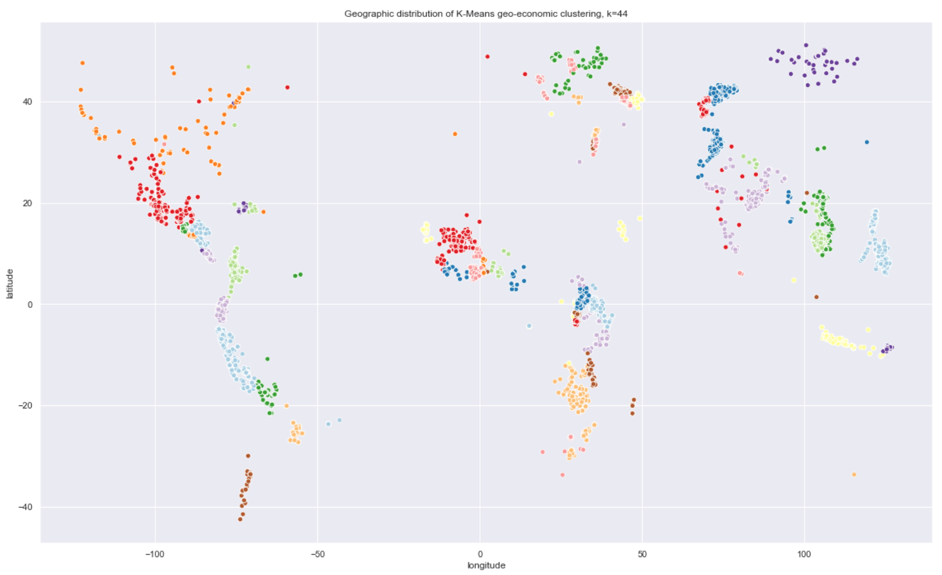
Geographic + Economic clusters

Slide 13
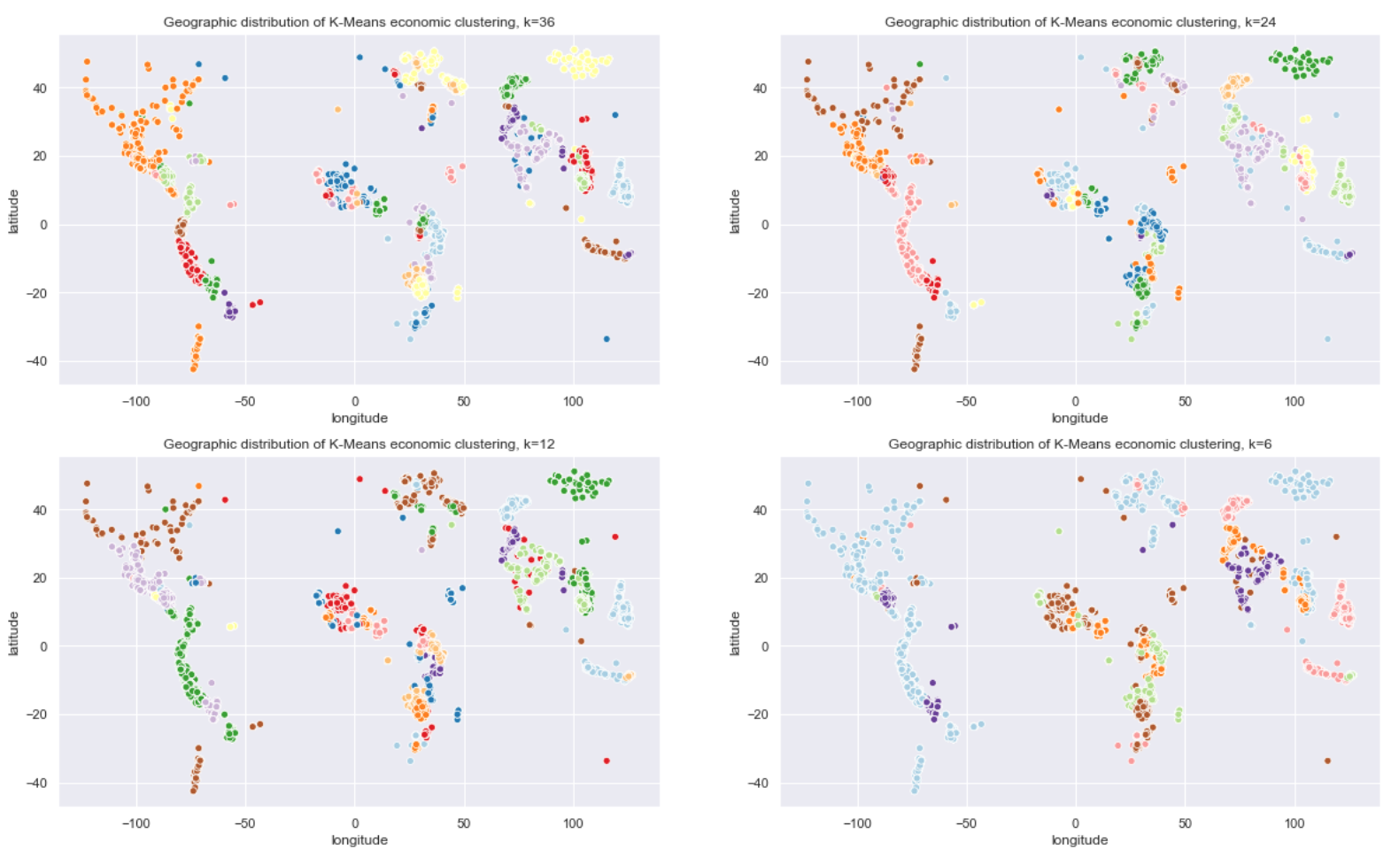
Purely economic clusters, K-Means

Slide 14
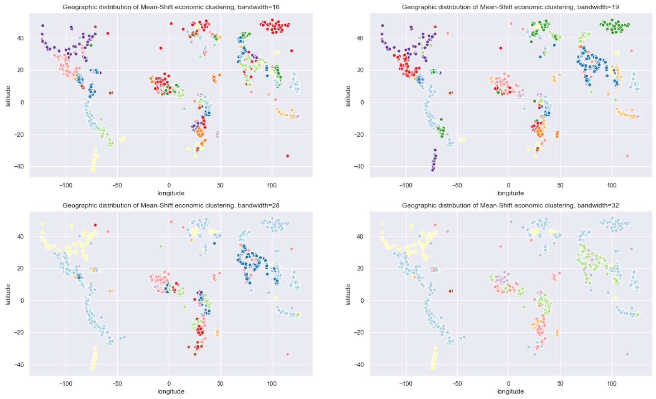
Purely economic clusters, Mean-Shift

Slide 15
PCA Generation
Take year and month features and convert them into two PCAs
loan_year_PCA
loan_month_PCA
Take the high-n categorical features, convert them into dummy-variables and then convert those ~800 binary features into a set of 20 PCA vectors
activity_name
sector_name
currency
partner_id
econ_ms19_cluster
econ_ms16_cluster
econ_k24_cluster
econ_k36_cluster
geoecon_k44_cluster

Slide 16
Final feature list
Base dataset features
original_language, loan_amount, currency_policy, lender_term, repayment_interval
National dataset features
country_code3, continent, region, population, population_below_poverty_line, hdi, life_expectancy, expected_years_of_schooling, mean_years_of_schooling, gni
Categorical dummy/PCA features
dummies_PCA_1 through dummies_PCA_20
borrowers_pictured features
pictured_borrowers, unpictured_borrowers, pictured_ratio
borrower_gender features
male_borrowers, female_borrowers, mixed_gender_borrowers, borrower_count
Time PCA features
loan_year_PCA, loan_month_PCA
Economic clustering features
econ_k6_cluster, econ_k12_cluster, econ_ms32_cluster, econ_ms28_cluster

Slide 17
Supervised Learning
SelectKBest
Identify top-performing algorithm
GridsearchCV
Narrow down feature list length
Run algorithm

Slide 18
SelectKBest
60 most important features, in order:
no tags
Parent
lender_term
loan_amount
loan_year_PCA
male_borrowers
user_favorite
dummies_PCA_1,
econ_k12_cluster
Vegan
Biz Durable Asset
Supporting Family
Repeat Borrower
dummies_PCA_10
country_code3
dummies_PCA_5
Repair Renew Replace
currency_policy
Single
Elderly
First Loan
Woman Owned Biz
Animals
original_language
dummies_PCA_20
dummies_PCA_12
dummies_PCA_13
Schooling
expected_years_of_ schooling
dummies_PCA_14
dummies_PCA_4
female_borrowers
Sustainable Ag
dummies_PCA_7
region
Job Creator
life_expectancy
Low-profit FP
repayment_interval
loan_month_PCA
dummies_PCA_9
Trees
population
gni
hdi
dummies_PCA_18
Hidden Gem
dummies_PCA_8
Refugee
dummies_PCA_11
Inspiring Story
dummies_PCA_17
continent
Unique
econ_k6_cluster
unpictured_borrowers
pictured_ratio
population_below_ poverty_line
Interesting Photo
Single Parent
dummy_PCA features
national features
tag features

Slide 19
Algorithm Comparison
Naïve Bayes Classifier
model accuracy = .81
f1 score for unfunded = .21
Logistic Regression
model accuracy = .93
f1 score for unfunded = .29
K-Nearest Neighbors Classifier
model accuracy = .91
f1 score for unfunded = .35
Decision Tree Classifier
model accuracy = .94
f1 score for unfunded = .44
Random Forest Classifier
model accuracy = .95
f1 score for unfunded = .5
Gradient Boosting Classifier
model accuracy = .93
f1 score for unfunded = .44

Slide 20
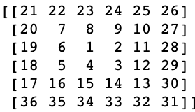
Neural Networks / Deep Learning
Multi-Layer Perceptron
model accuracy = .92
f1 score for unfunded = .44
Keras / TensorFlow
model accuracy = .94
f1 score for unfunded = .25
Convolutional Neural Network
model accuracy = .93
f1 score for unfunded = .27
See 4.1.a Spiral SelectKBest feature-set creation and the functions ‘spiral’ and ‘create_spiral_features’ for more on the creation of the spiral array

Slide 21
Final Result: RFC
GridsearchCV Parameters:
class_weight = 'balanced_subsample’
max_depth = None
max_features = 'log2’
n_estimators = 100
Optimum feature list
length is 36
Final RFC Model
Score: 95.519%
Funded | Unfunded
Precision .98 .47
Recall .97 .59
f1 score .98 .53
Cross-Valuation:
.9617, .9621, .9614, .9609, .9614

Slide 22
Lessons Learned
Factors leading to expiration without funding are not reliably predictable from these features
Multiple features are faintly but distinctly correlated, but no clear determinative factors that the models can find
Many loans are nearly identical in features, but have different outcomes with regard to funding
Other takeaways:
Target features for Kiva to watch for / ameliorate
#Puzzle

Slide 23
#Puzzle
Tags should make a loan easier for lenders to find and thus more likely to fund
However!
The presence of tags is correlated with a (slightly) lower rate of successful funding

Slide 24
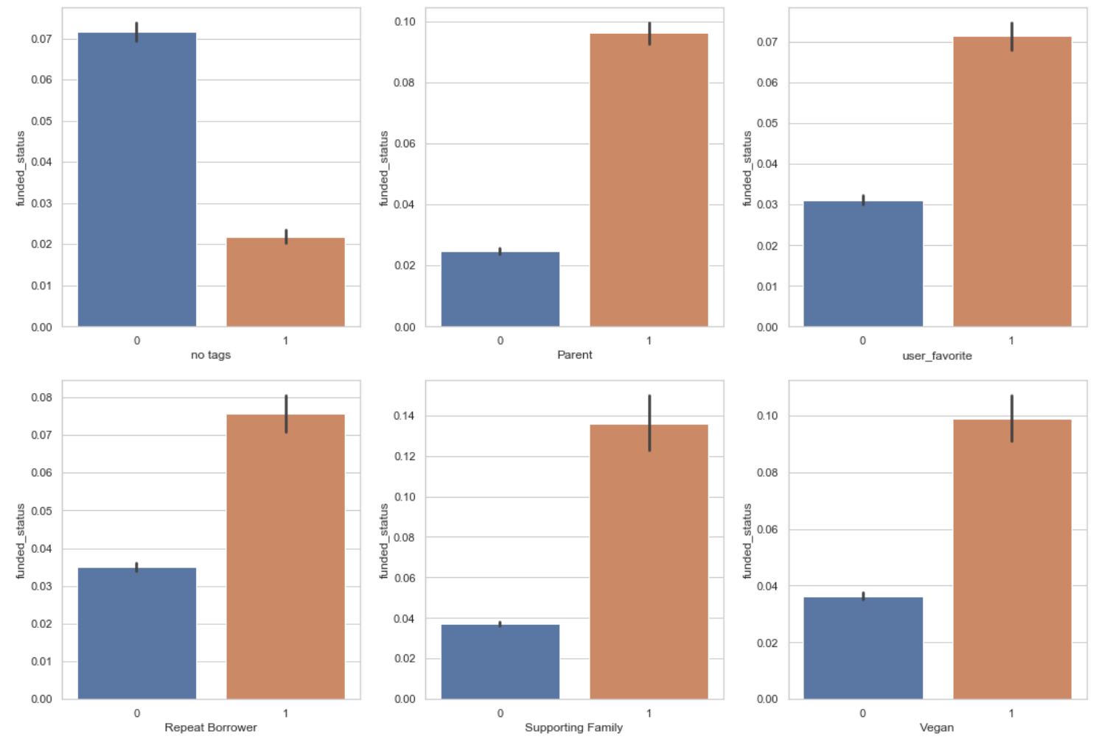
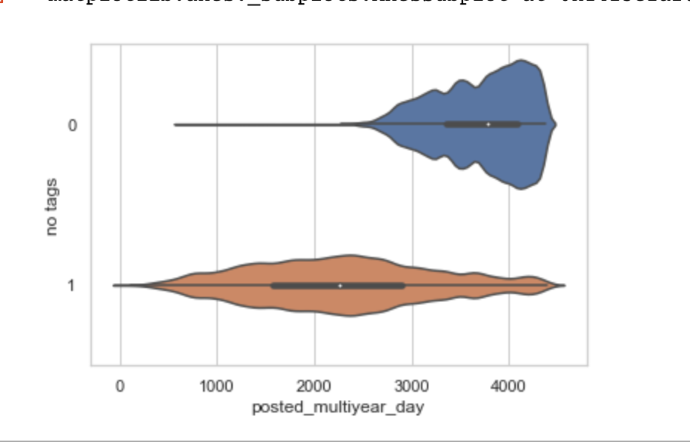
Tags & Funding
‘no tags’ & ‘funded_status’
t = 59.9
p < .001

Slide 25
Hypotheses
Why do tags have this correlation?
Tags just don’t have the impact we’d expect
Something about them being on a loan either convinces lenders that this loan doesn’t need their money as much as another one or does something else to reduce the funding given to such loans
Odd, but still worthwhile information about a loan
Tags are added to failing loan profiles
Kiva could be actively going through and adding tags to loans that are struggling to meet their goals, in an attempt to get more eyeballs on the profile and thus more money to fund it
Would invalidate many conclusions we could draw if we use them as part of our algorithm

Slide 26
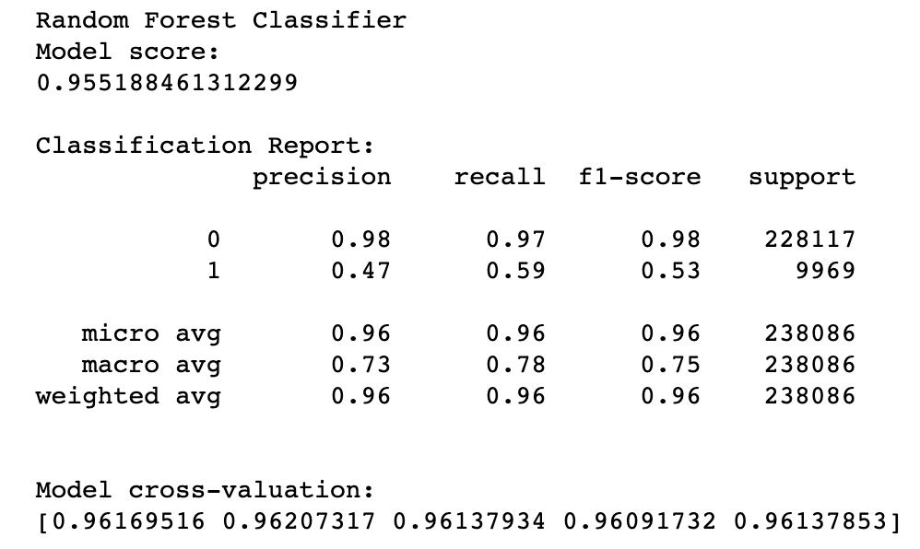
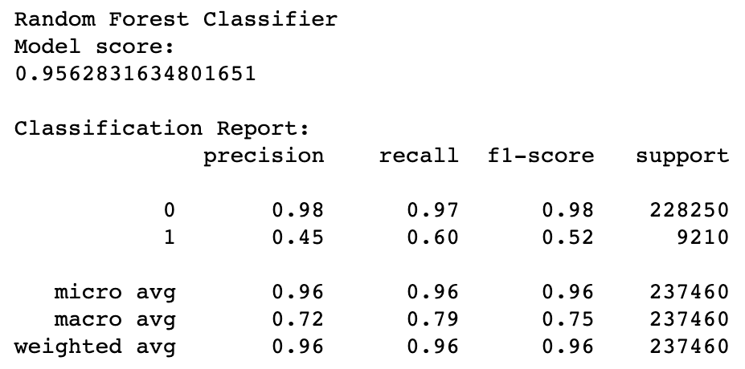
With & Without Tags Comparison
With tags:
Without tags:

Slide 27
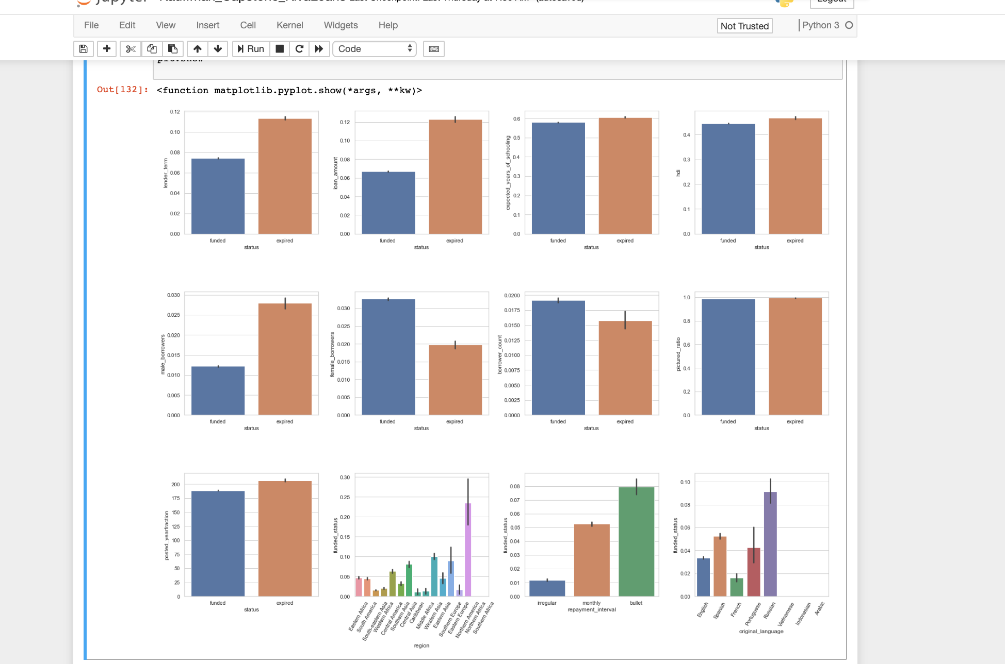
Other variables

Slide 28
Practical Usage
Screening for loans at high risk of failure to fund
Would highlight some problematic loans, though not reliably enough to depend on alone
Not a replacement for any kind of screening already in use
Would need to be used in addition to their normal vetting and any other algorithms they might be employing

Slide 29
Shortcomings
Model performance is not enough to rely on
NLP-dependent features are left out of the feature-set entirely, likely missing out on a lot of relevant information
Potentially other factors, unclear at this time

Slide 30
Further Explorations
NLP features explored/generated
Optimization of the dummy-PCA features
Deeper analysis of funding rates by time period
More expansive approach to clustering
Integrating localized poverty/economic data

